Slide 1
AI- Assisted analog layout optimization for process mitigation
By
Gurukaushik . S
Department of Electronics and Communication
Engineering

Slide 2

Problem
Analog layout migration across technology nodes is manual and time-consuming
Unlike digital circuits, automation is very limited
Designers must ensure symmetry, matching, and proper routing
Parasitic effects make the process more complex and error-prone

Slide 3
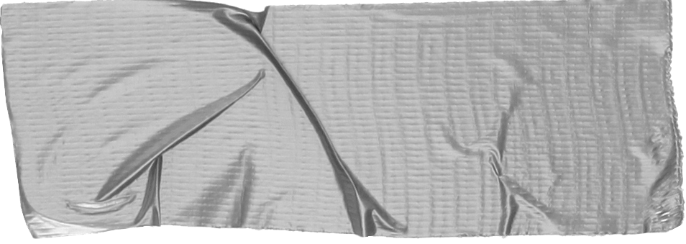

Objective
To develop a prototype AI-assisted optimization system
Convert analog layouts into a graph-based representation
Analyze circuit connectivity and structure
Improve placement while preserving symmetry and functionality

Slide 4
Approach
Input layout is represented in a grid or structured format
Convert layout into a graph (nodes and connections)
Apply symmetry detection and optimization rules
Generate an improved layout with reduced complexity

Slide 5
Expected Results
Improved symmetry in device placement
Reduction in total wire length (parasitic proxy)
Better layout efficiency and organization
Faster design compared to manual methods

Slide 6
Technical Highlights
Graph-based modeling using Python
Rule-based optimization techniques
Wire length used as a cost function
Foundation for future AI/ML-based enhancements

Slide 7
Future Scope
Integration of Graph Neural Networks (GNN)
Support for real GDSII layout data
Advanced parasitic-aware optimization
Potential integration with industry EDA tools

Slide 8
Conclusion
Combines AI concepts with core VLSI design challenges
Addresses a real problem in semiconductor industry
Prototype demonstrates feasibility of automation
Scalable towards advanced design tools

Slide 9

THANK YOU

